Slide 1

QUESTION

Slide 2
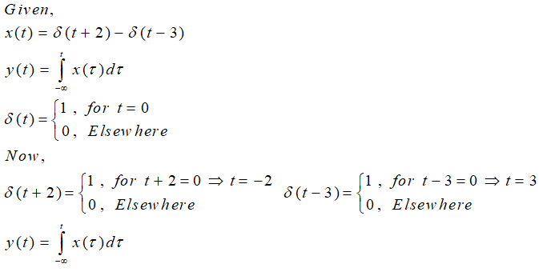
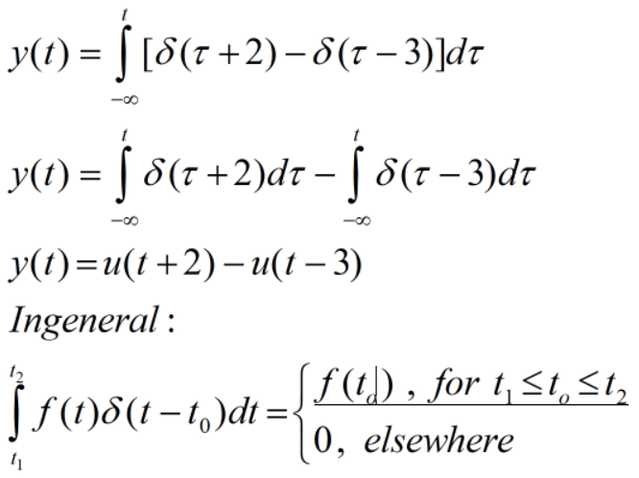
Q1|ANALYTICAL APPROACH

Slide 3
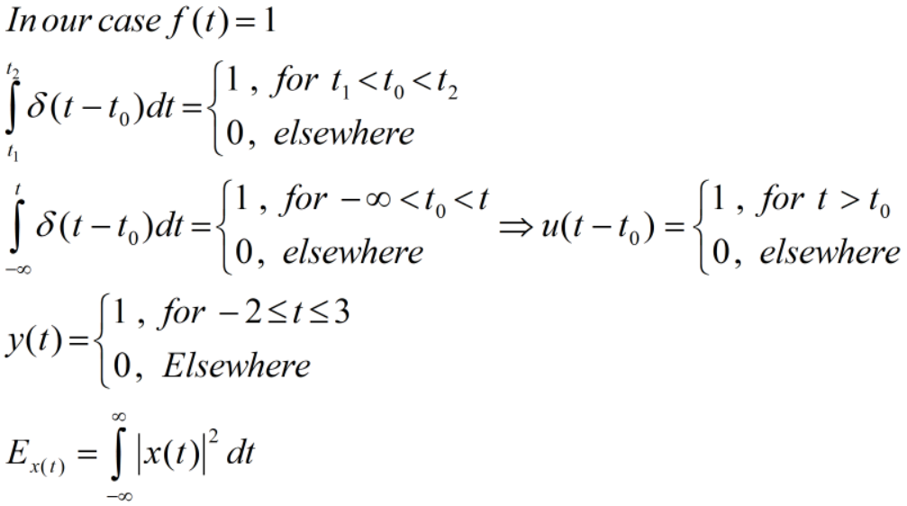
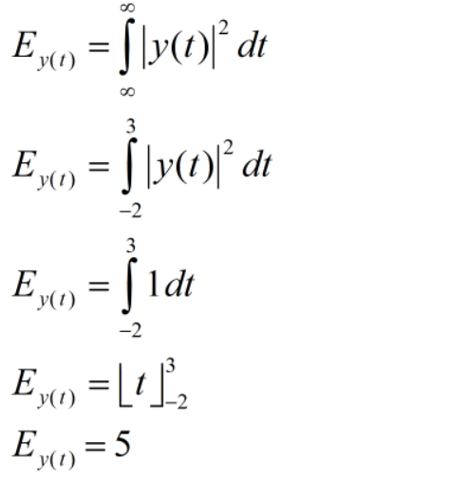
Q1|ANALYTICAL APPROACH

Slide 4
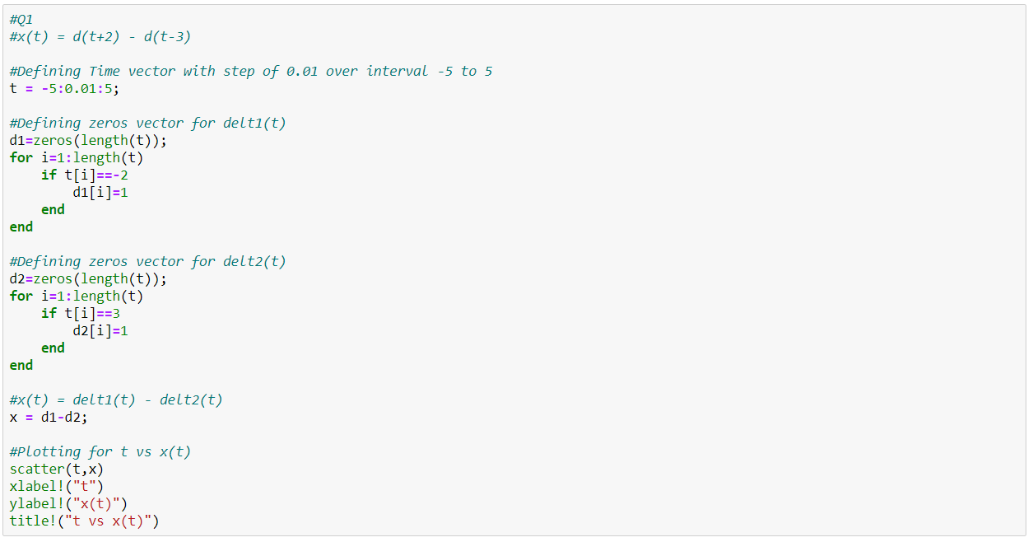
Q1|JULIA CODING

Slide 5
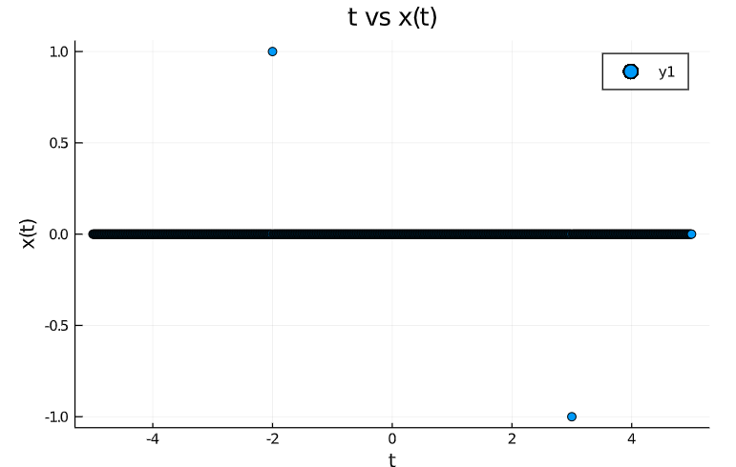
Q1|JULIA CODING

Slide 6
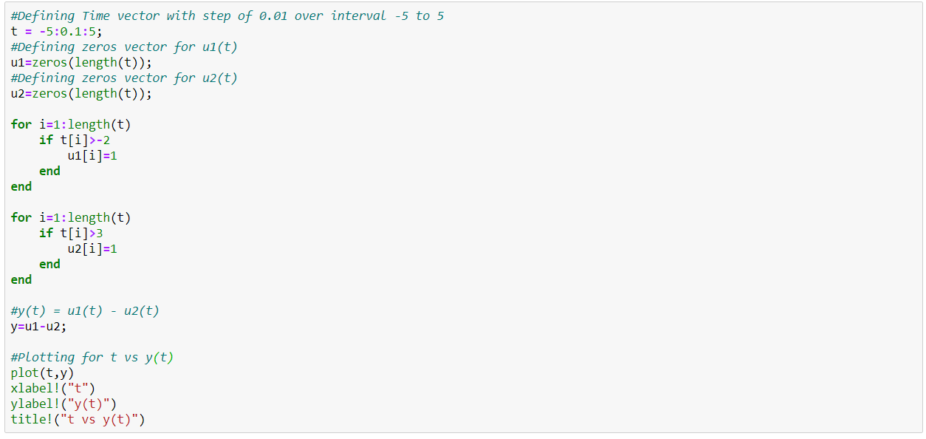
Q1|JULIA CODING

Slide 7
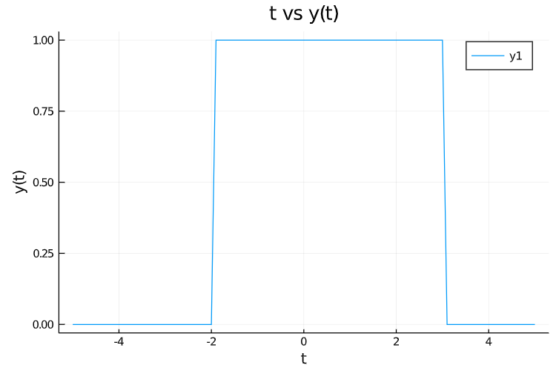
Q1|JULIA CODING

Slide 8
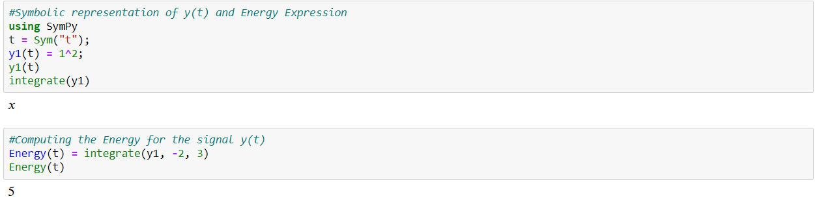
Q1|JULIA CODING

Slide 9

QUESTION

Slide 10
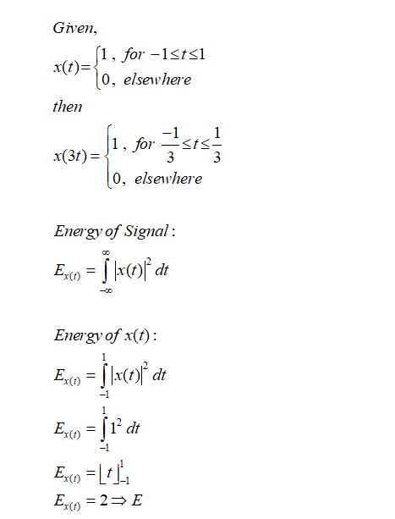
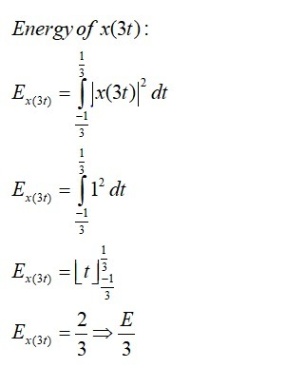
Q2|ANALYTICAL APPROACH

Slide 11
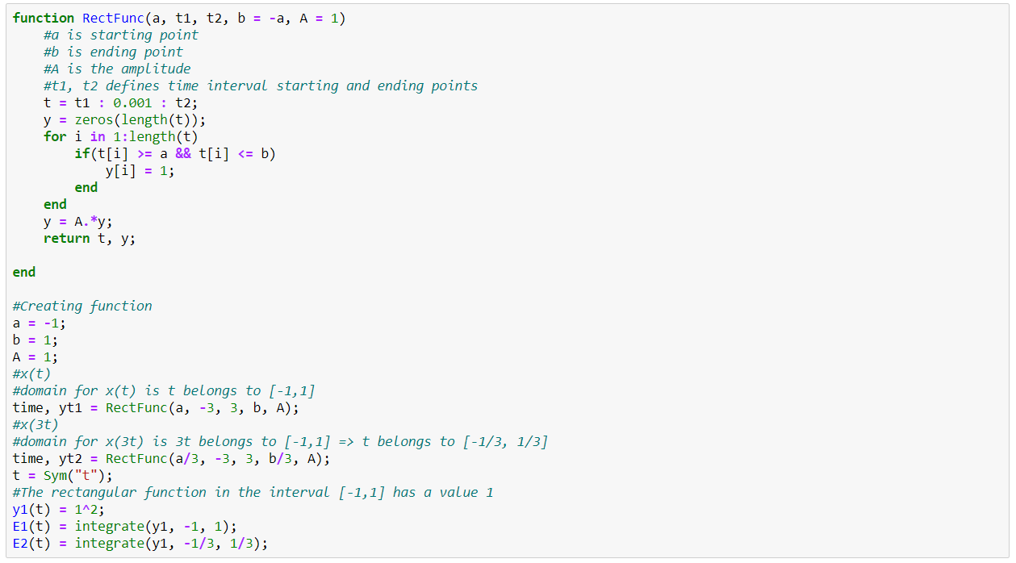
Q2|JULIA CODING

Slide 12
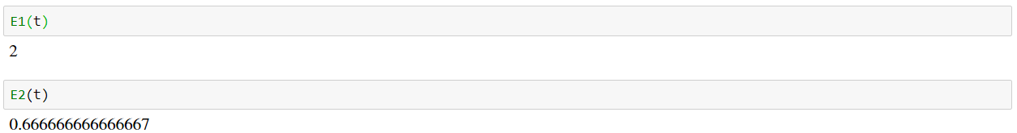
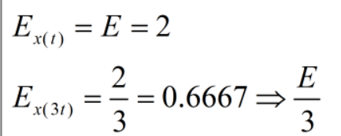
Q2|JULIA CODING

Slide 13
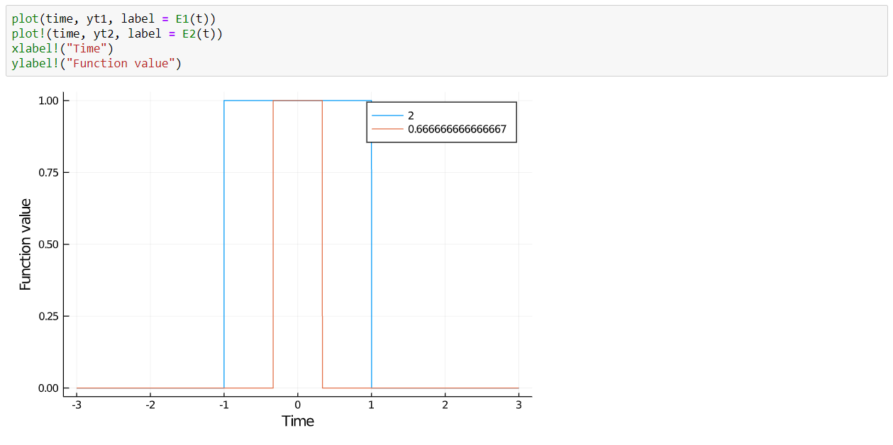
Q2|JULIA CODING

Slide 14
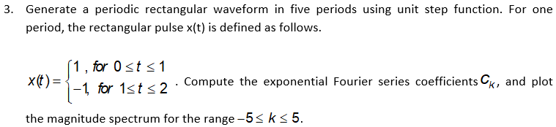
QUESTION

Slide 15
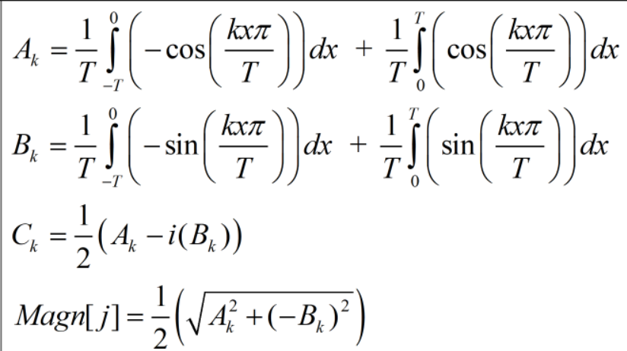
Q3|ANALYTICAL APPROACH
Magn[j] gives the Fourier coefficient corresponding to each value of k from -5 to 5

Slide 16
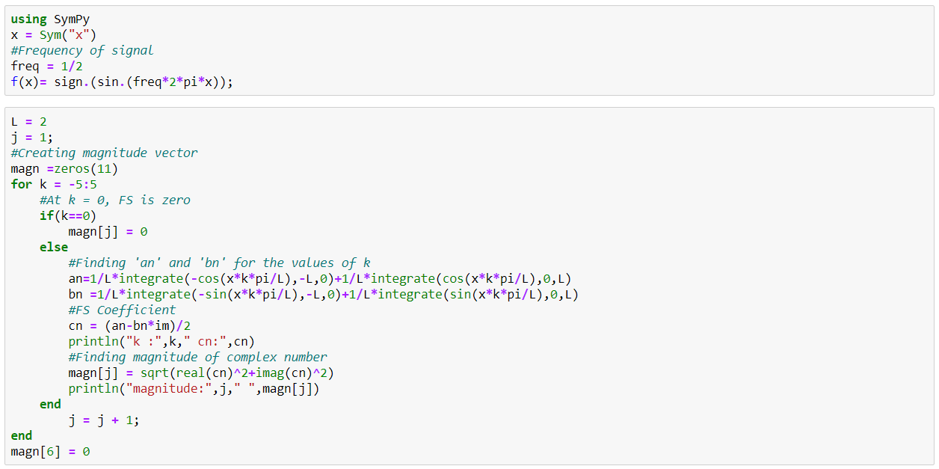
Q3|JULIA CODING

Slide 17
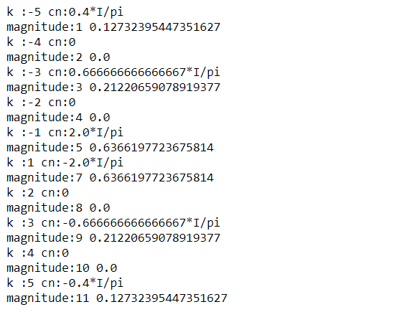
Q3|JULIA CODING

Slide 18
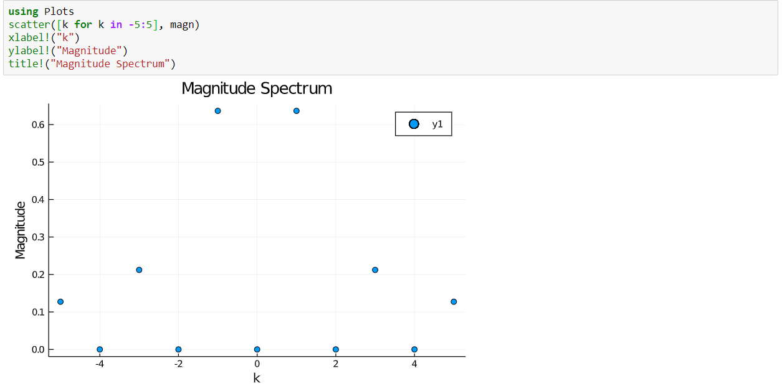
Q3|JULIA CODING

Slide 19
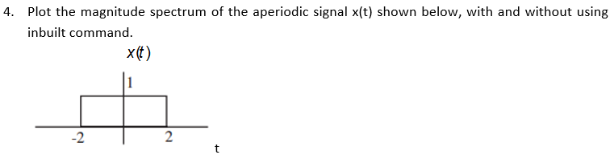
QUESTION

Slide 20
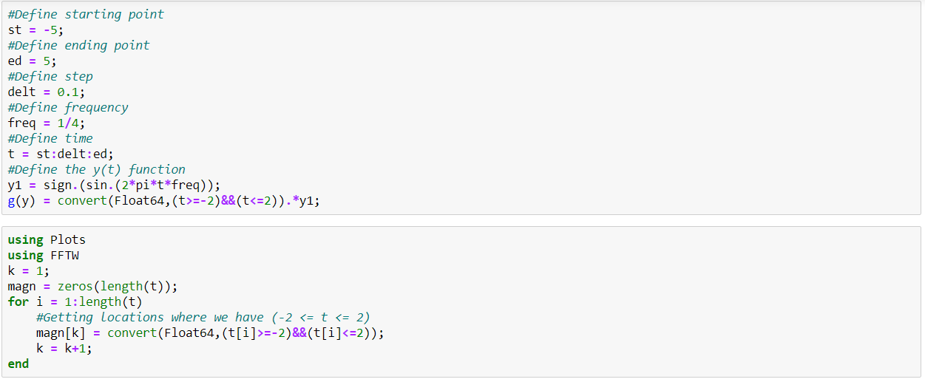
Q4|JULIA CODING|INBUILT FUNCTION

Slide 21
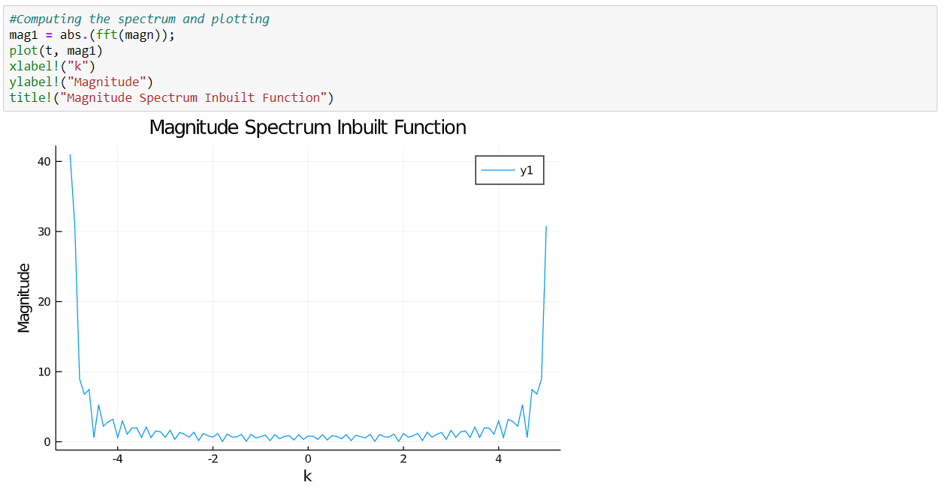
Q4|JULIA CODING|INBUILT FUNCTION

Slide 22
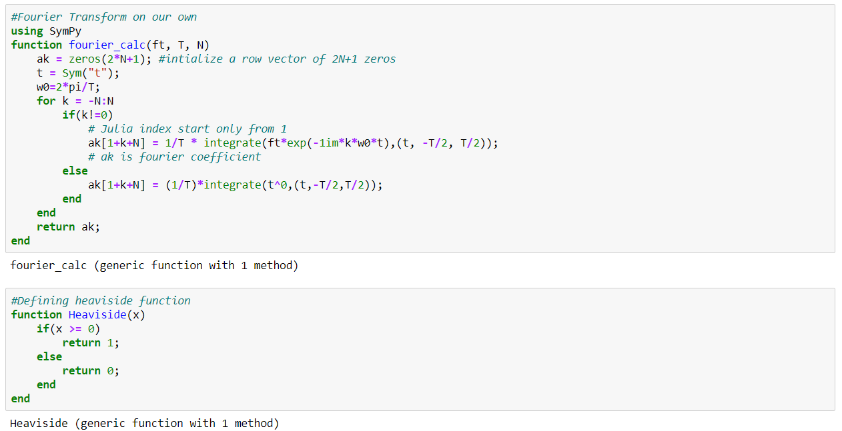
Q4|JULIA CODING|Without inbuilt function

Slide 23
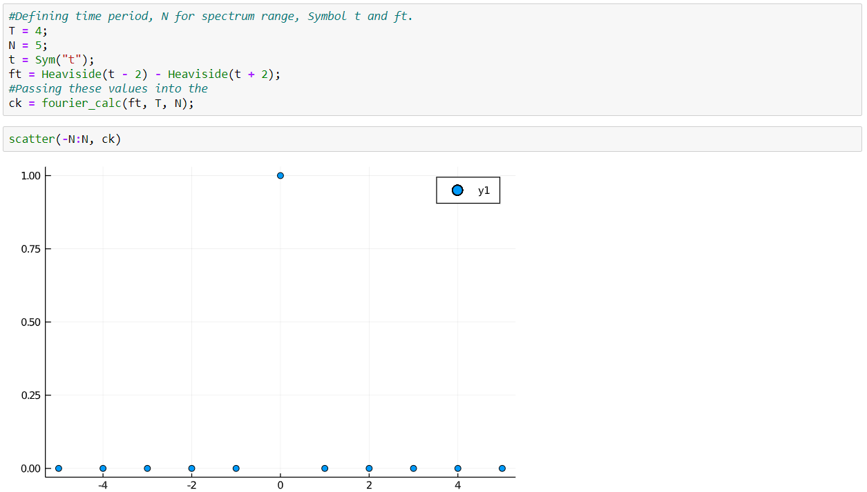
Q4|JULIA CODING|Without inbuilt function

Slide 24
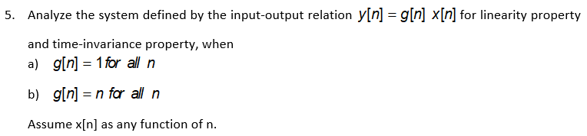
QUESTION

Slide 25
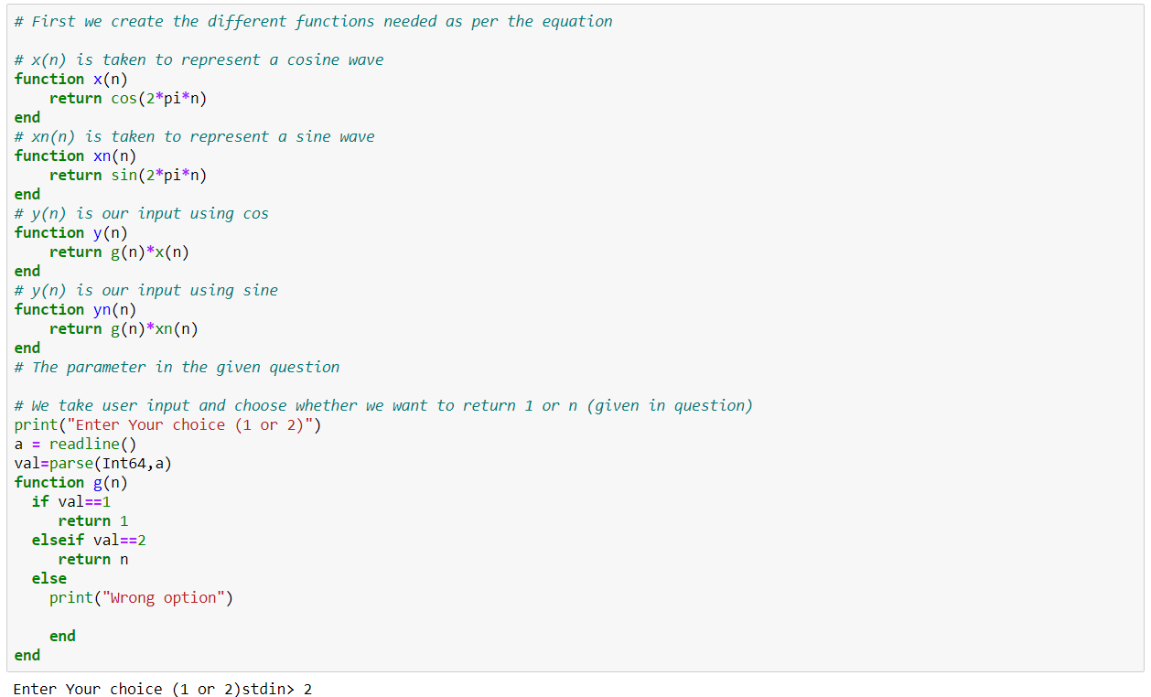
Q5|JULIA CODING

Slide 26
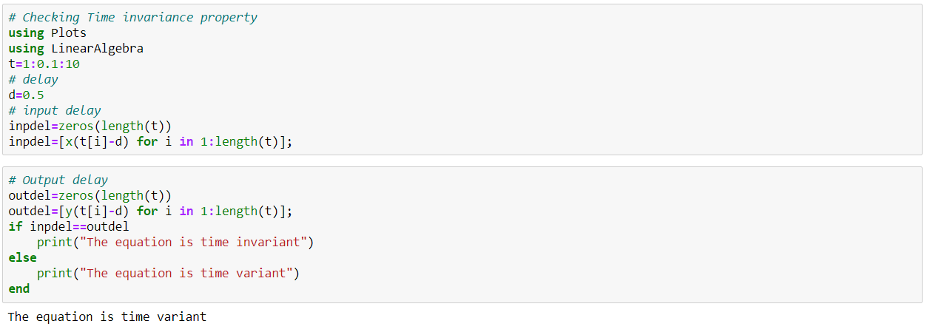
Q5|JULIA CODING

Slide 27
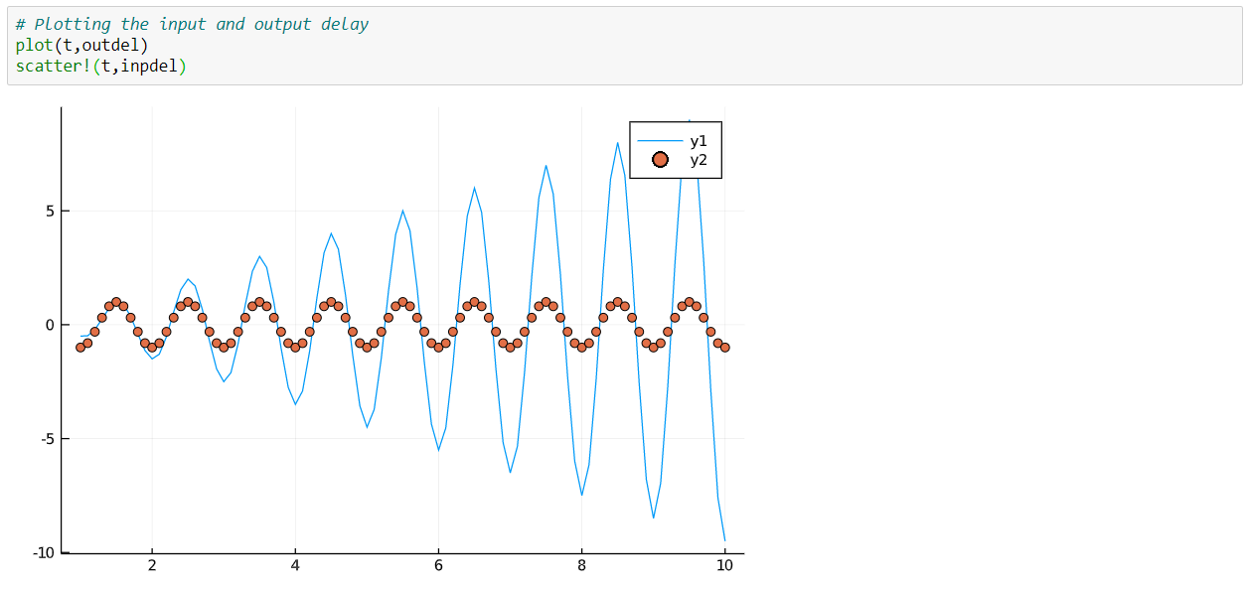
Q5|JULIA CODING

Slide 28
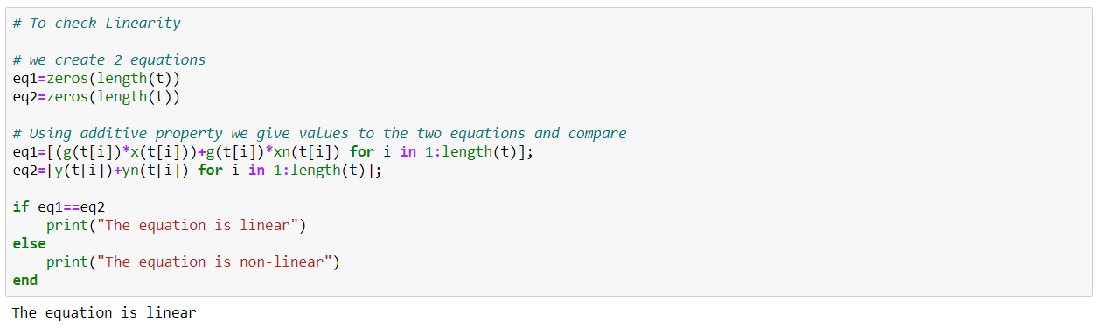
Q5|JULIA CODING

Slide 29
Thank you…

